Slide 1
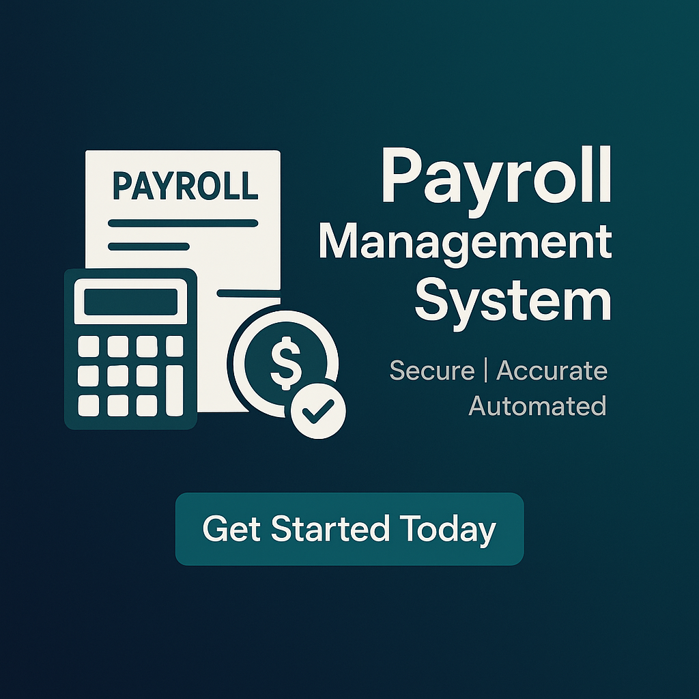
ADVANCE PAYROLL MANAGEMENT SYSTEM
Introduction
The Salary and Payroll Management System (SPMS) is a web-based tool that automates payroll tasks, including employee data management, salary calculation, and payslip generation with tax handling. Built with PHP, MySQL, JavaScript, and Bootstrap, it's a lightweight yet robust solution for small to mid-sized businesses.
Akhilesh Kumar-028
Akhilesh Kumar-027
Parth Bhardwaj-173
Krish - 136

Slide 2
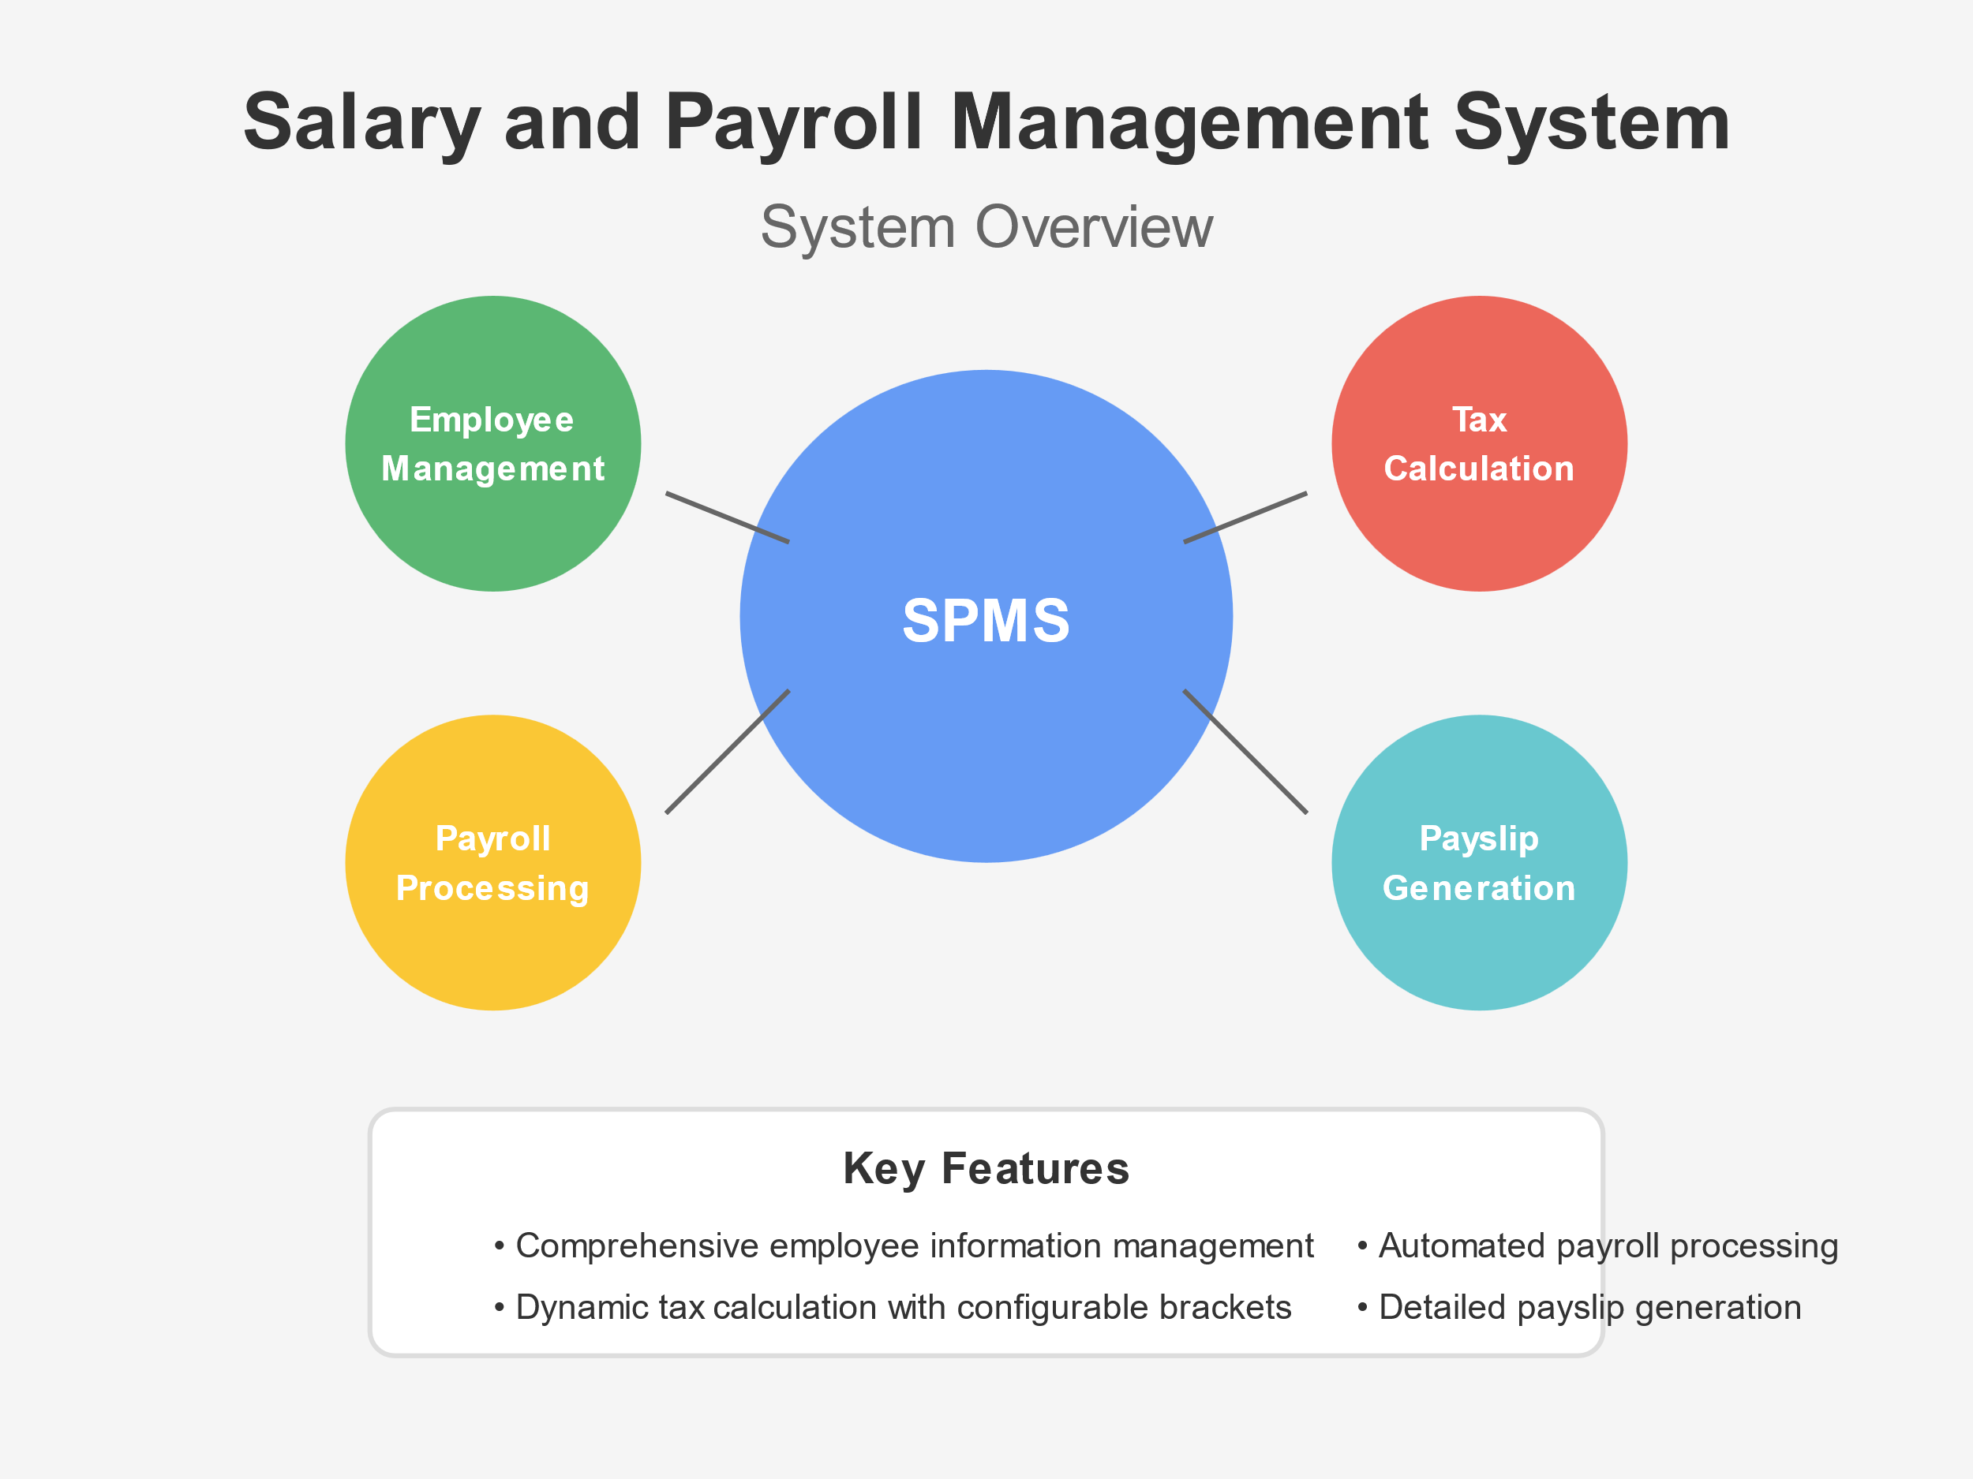

Slide 3
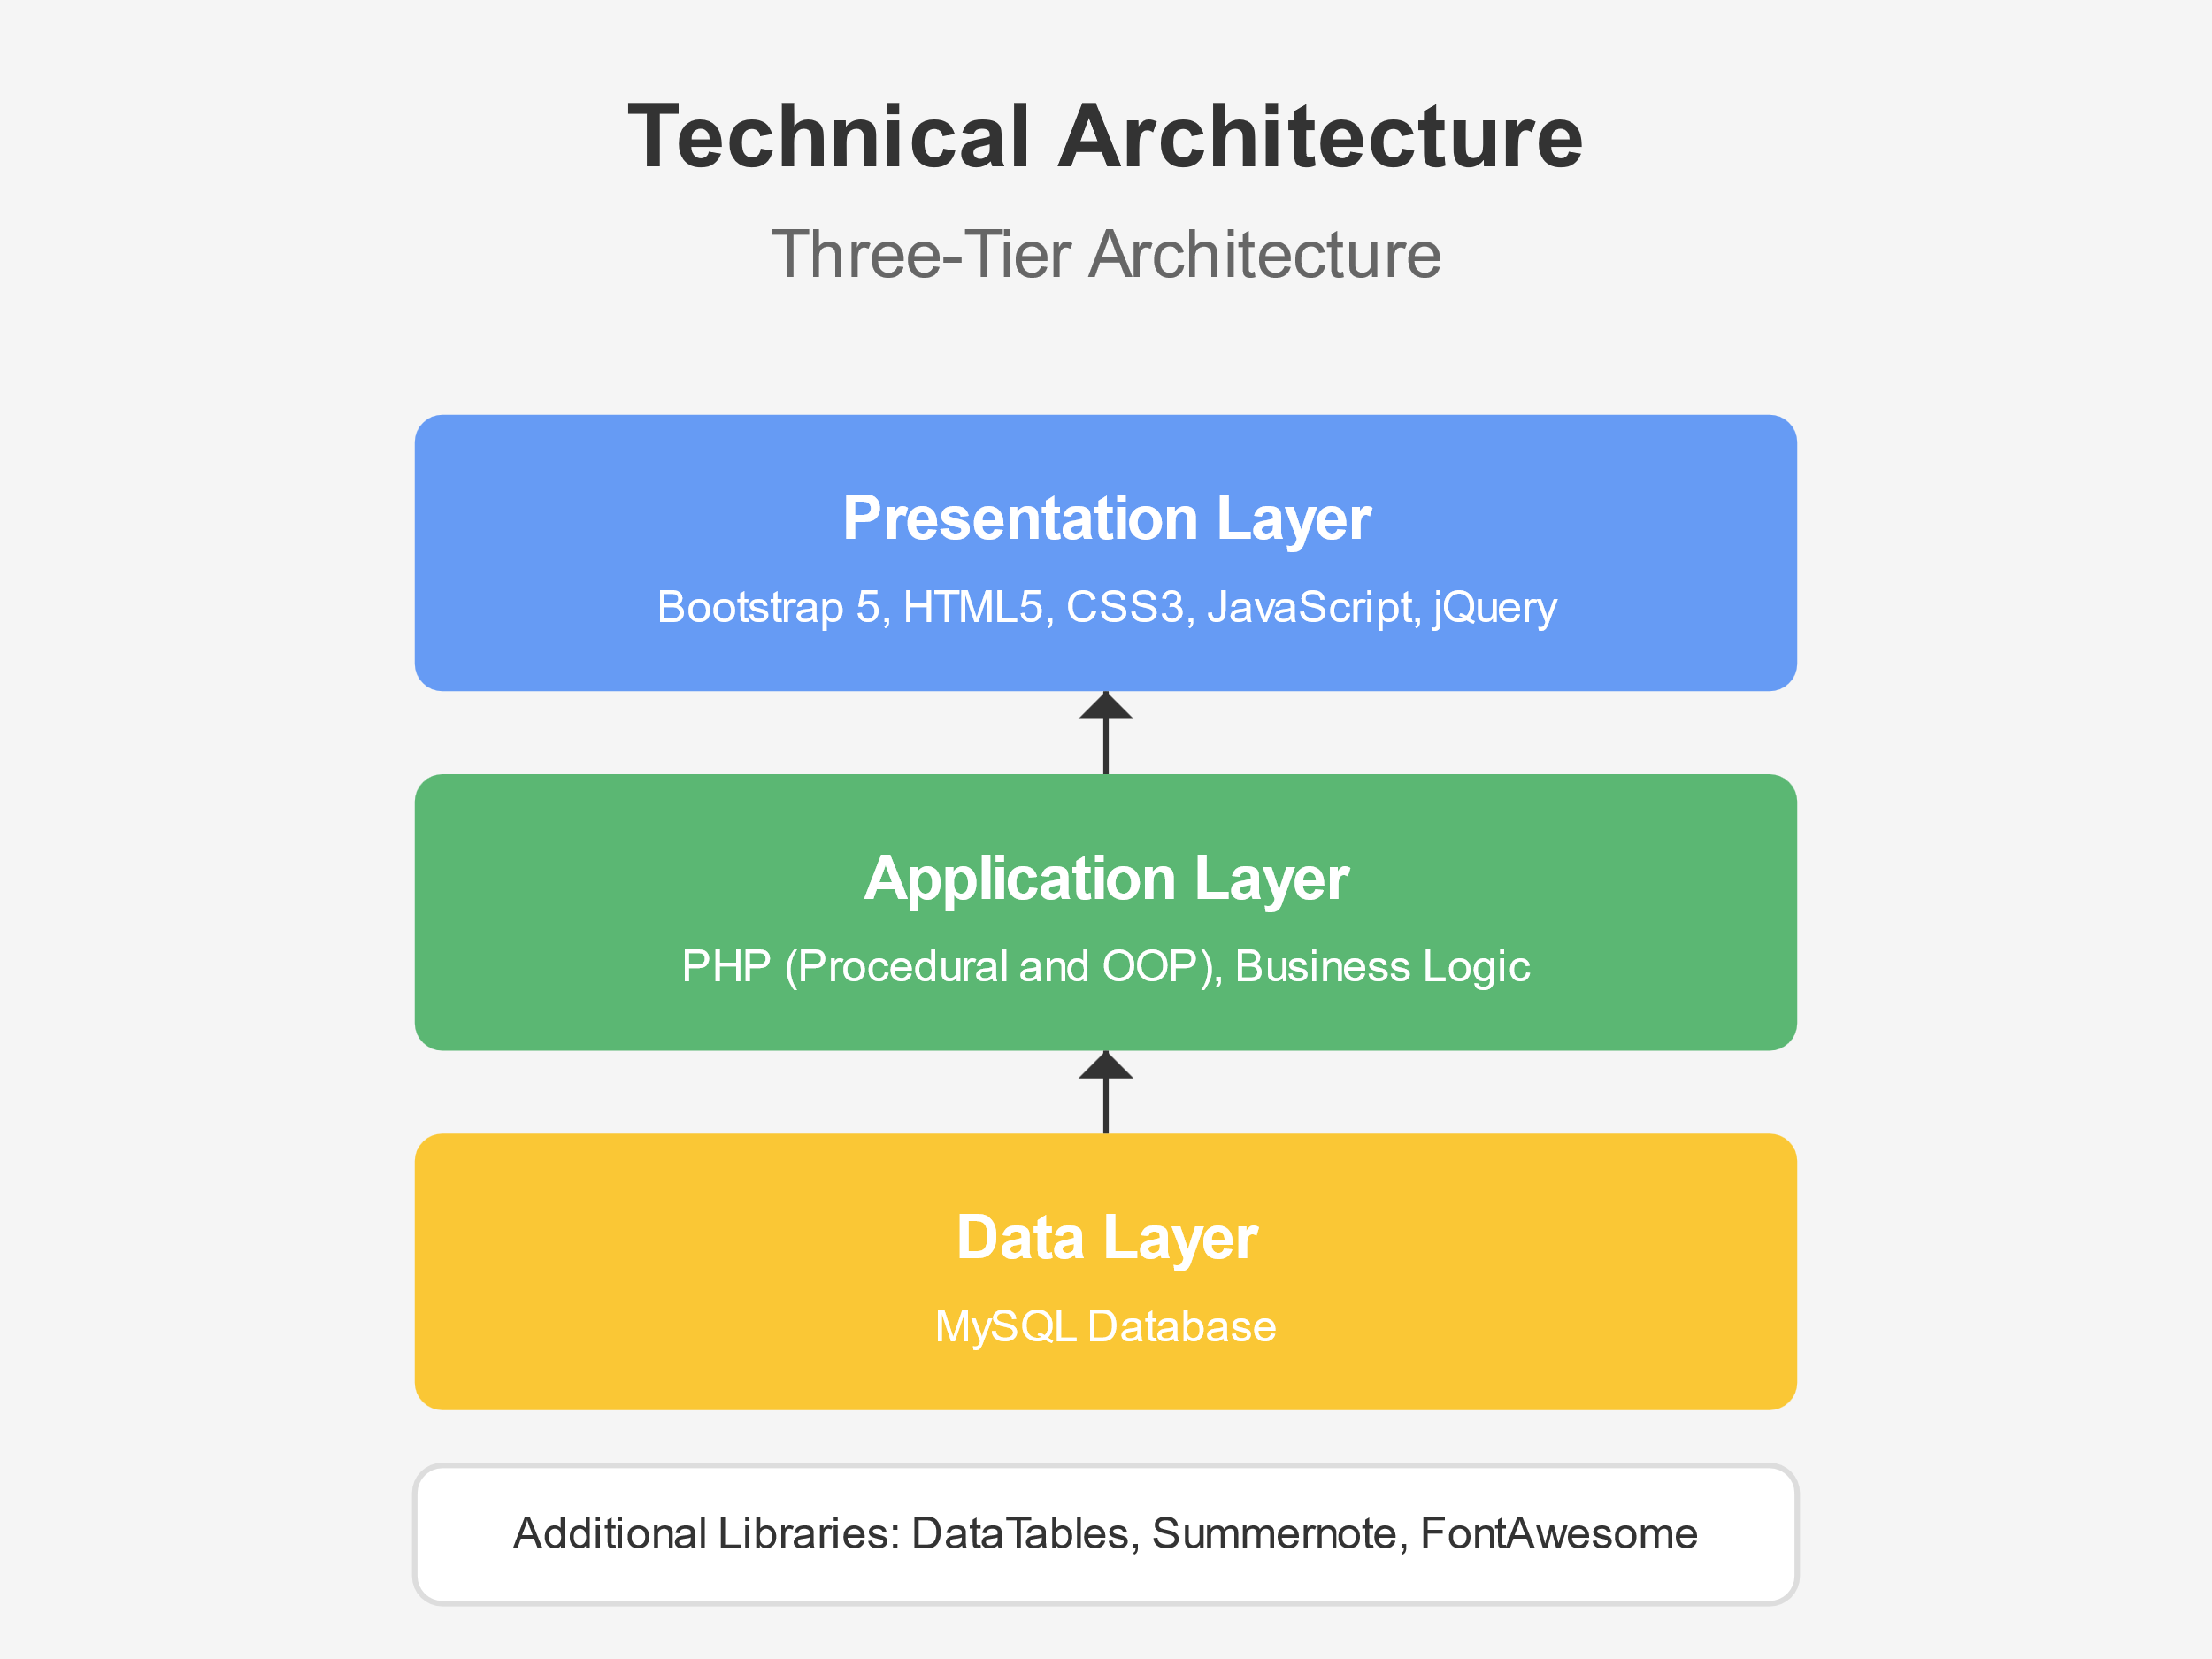

Slide 4
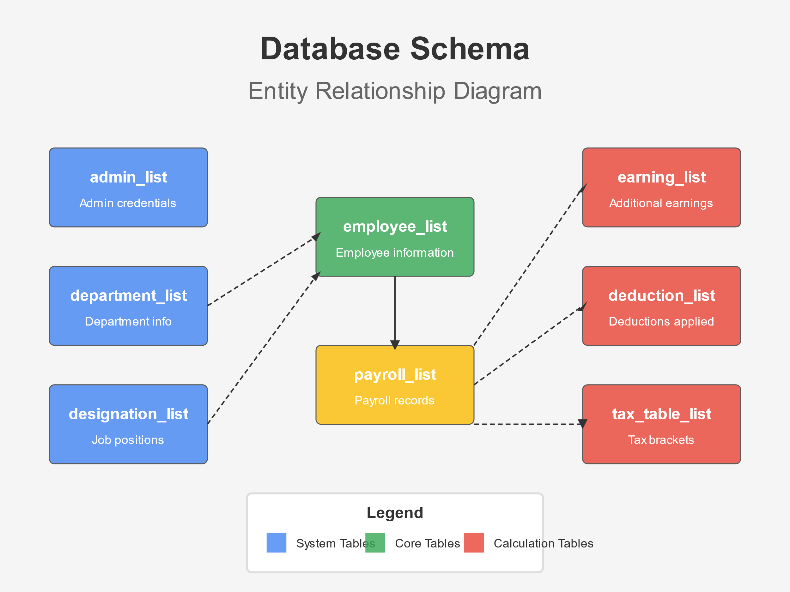

Slide 5
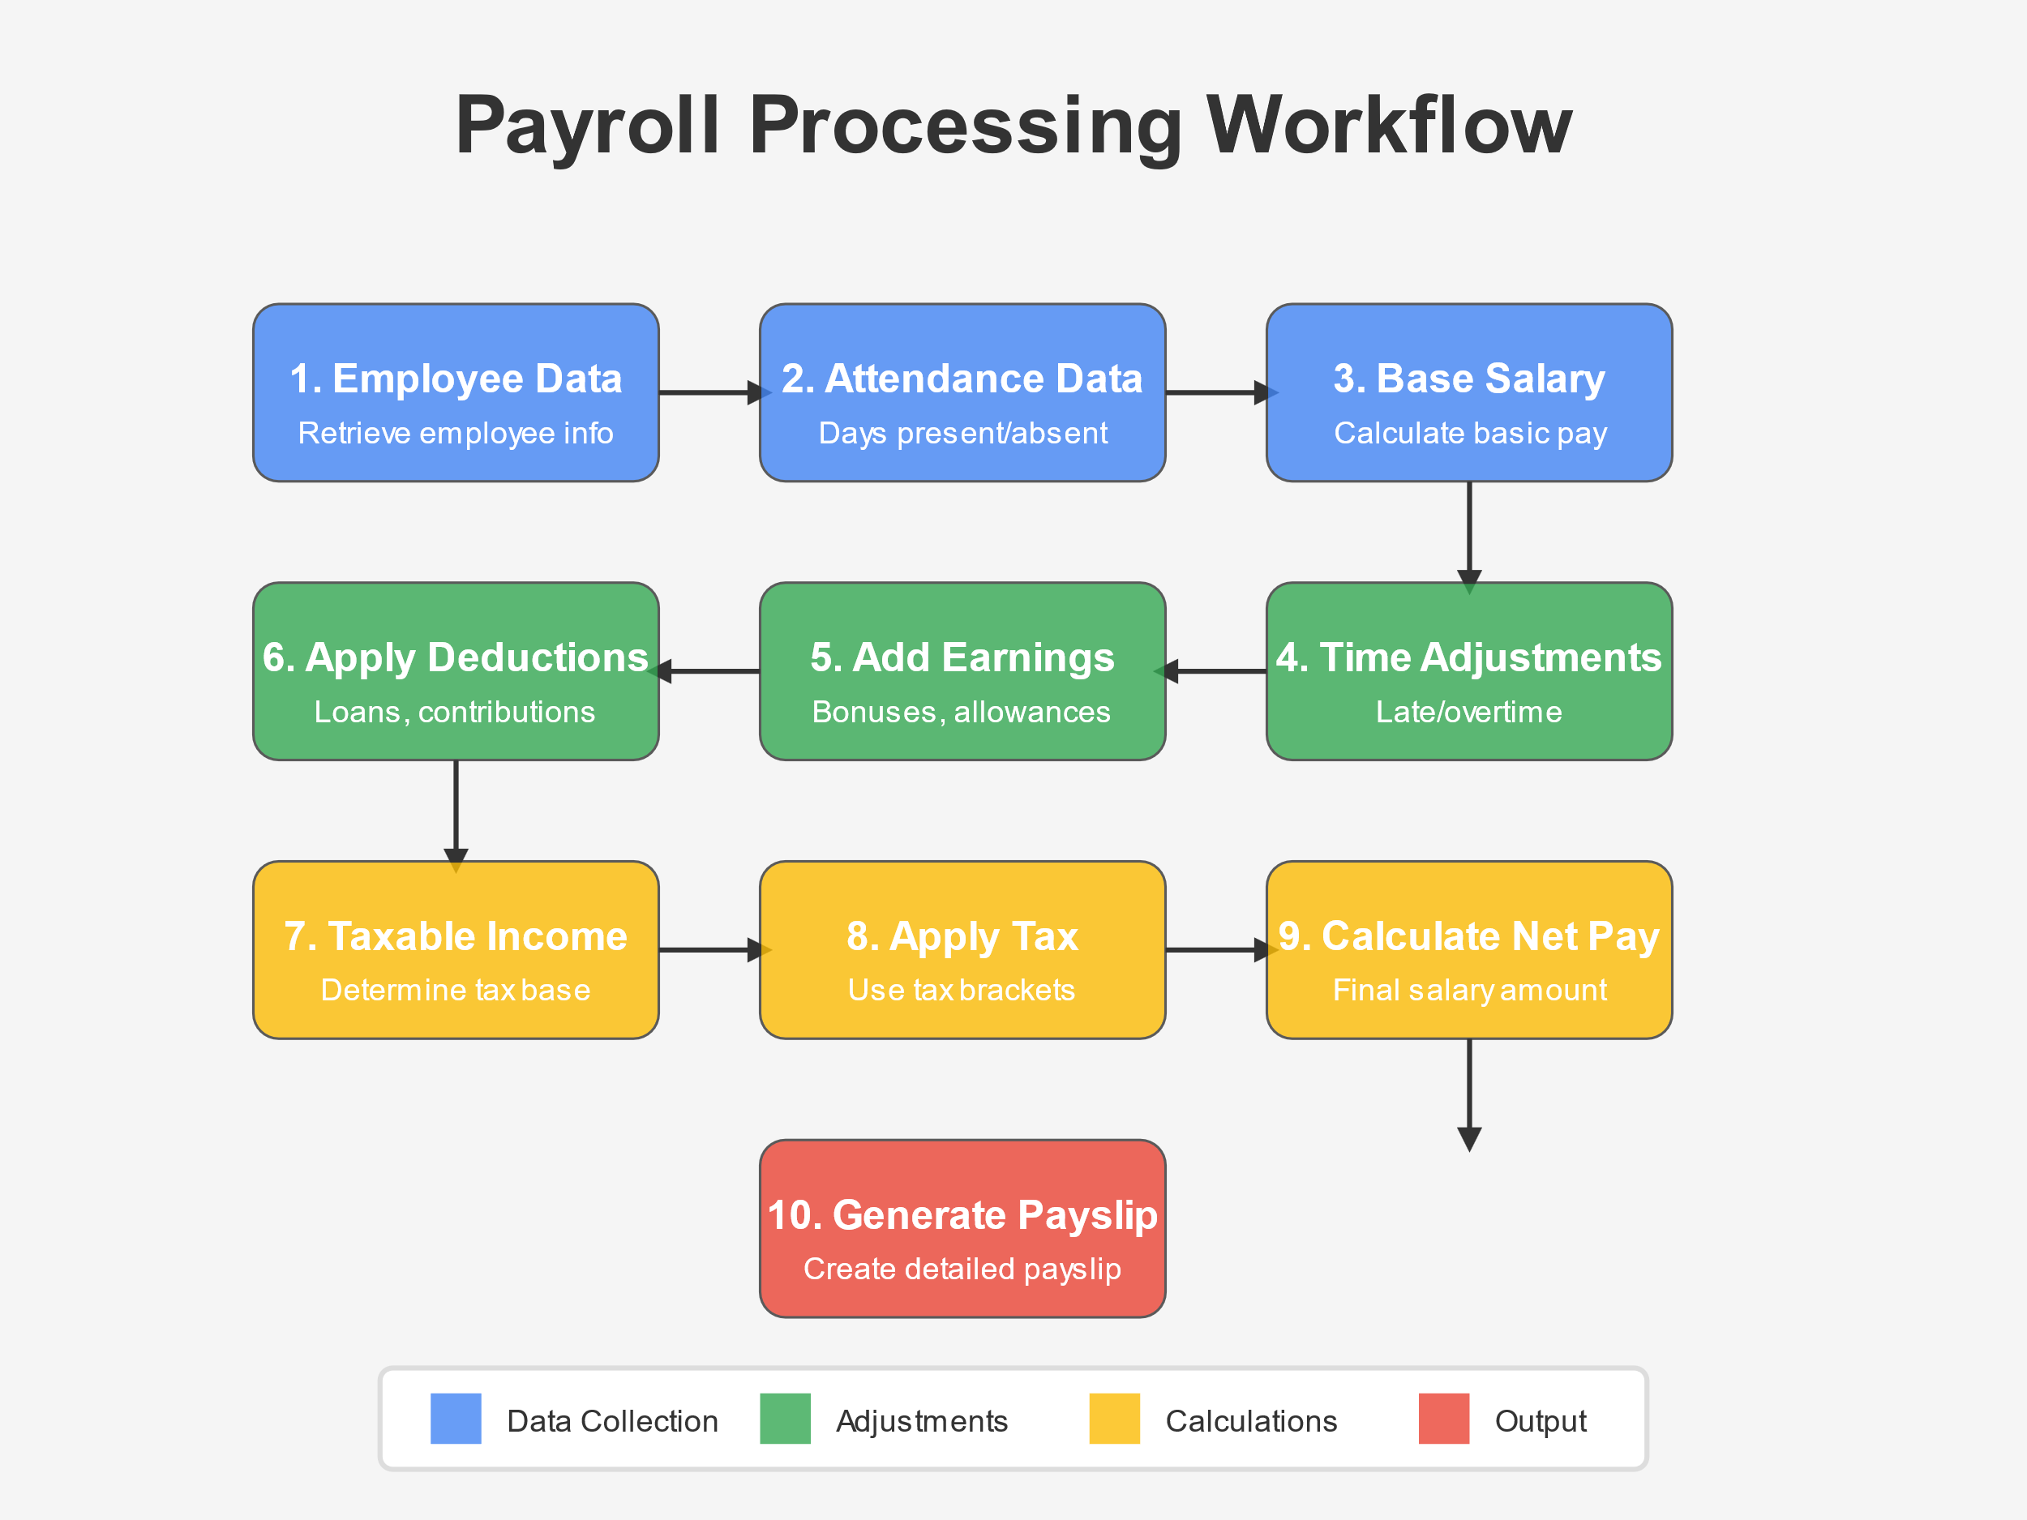

Slide 6
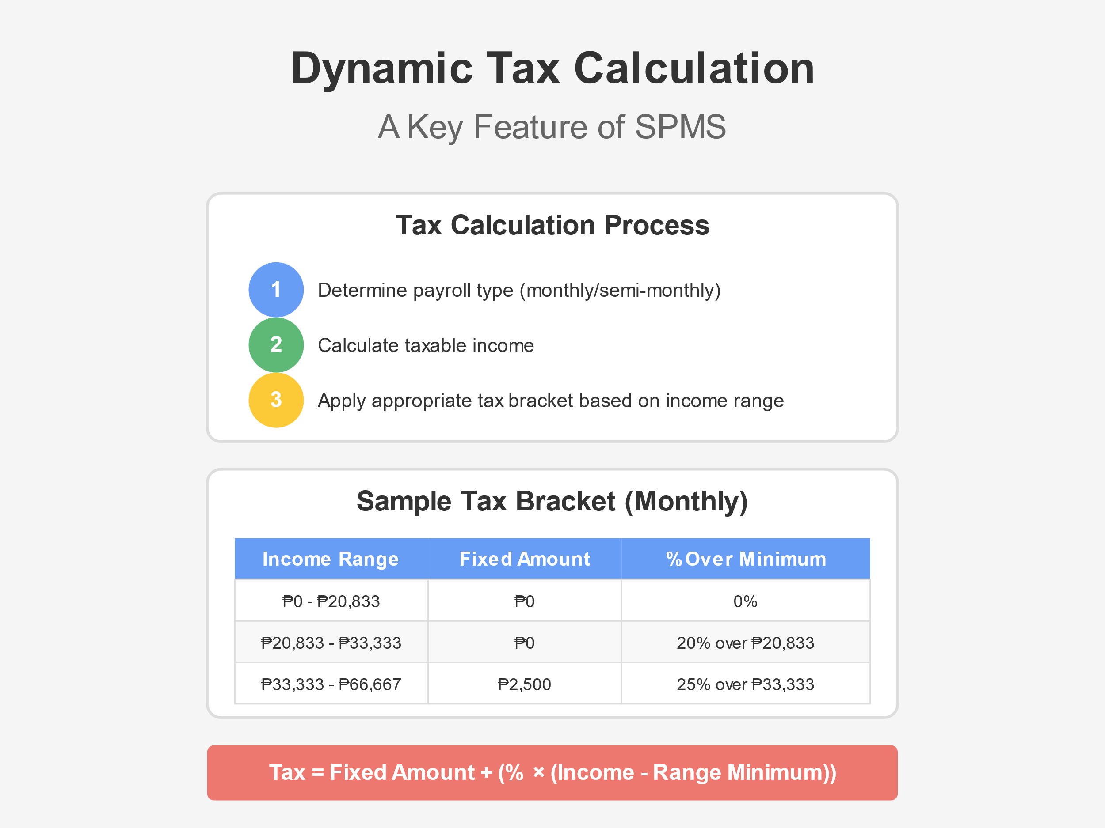

Slide 7
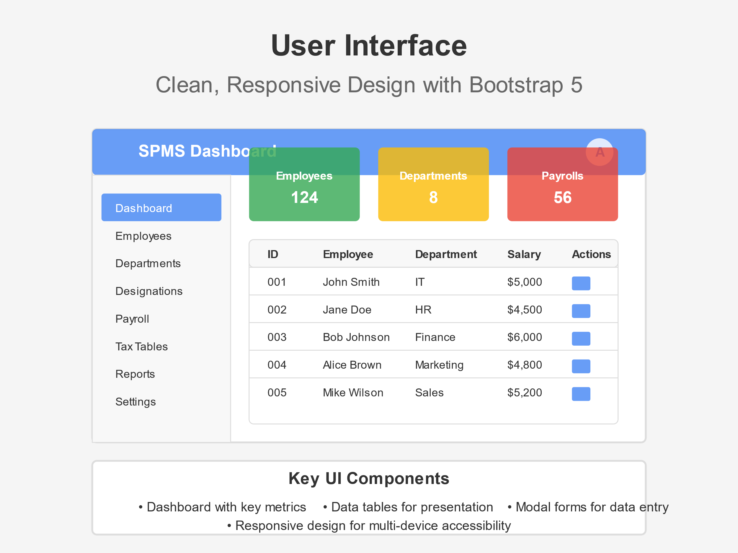

Slide 8
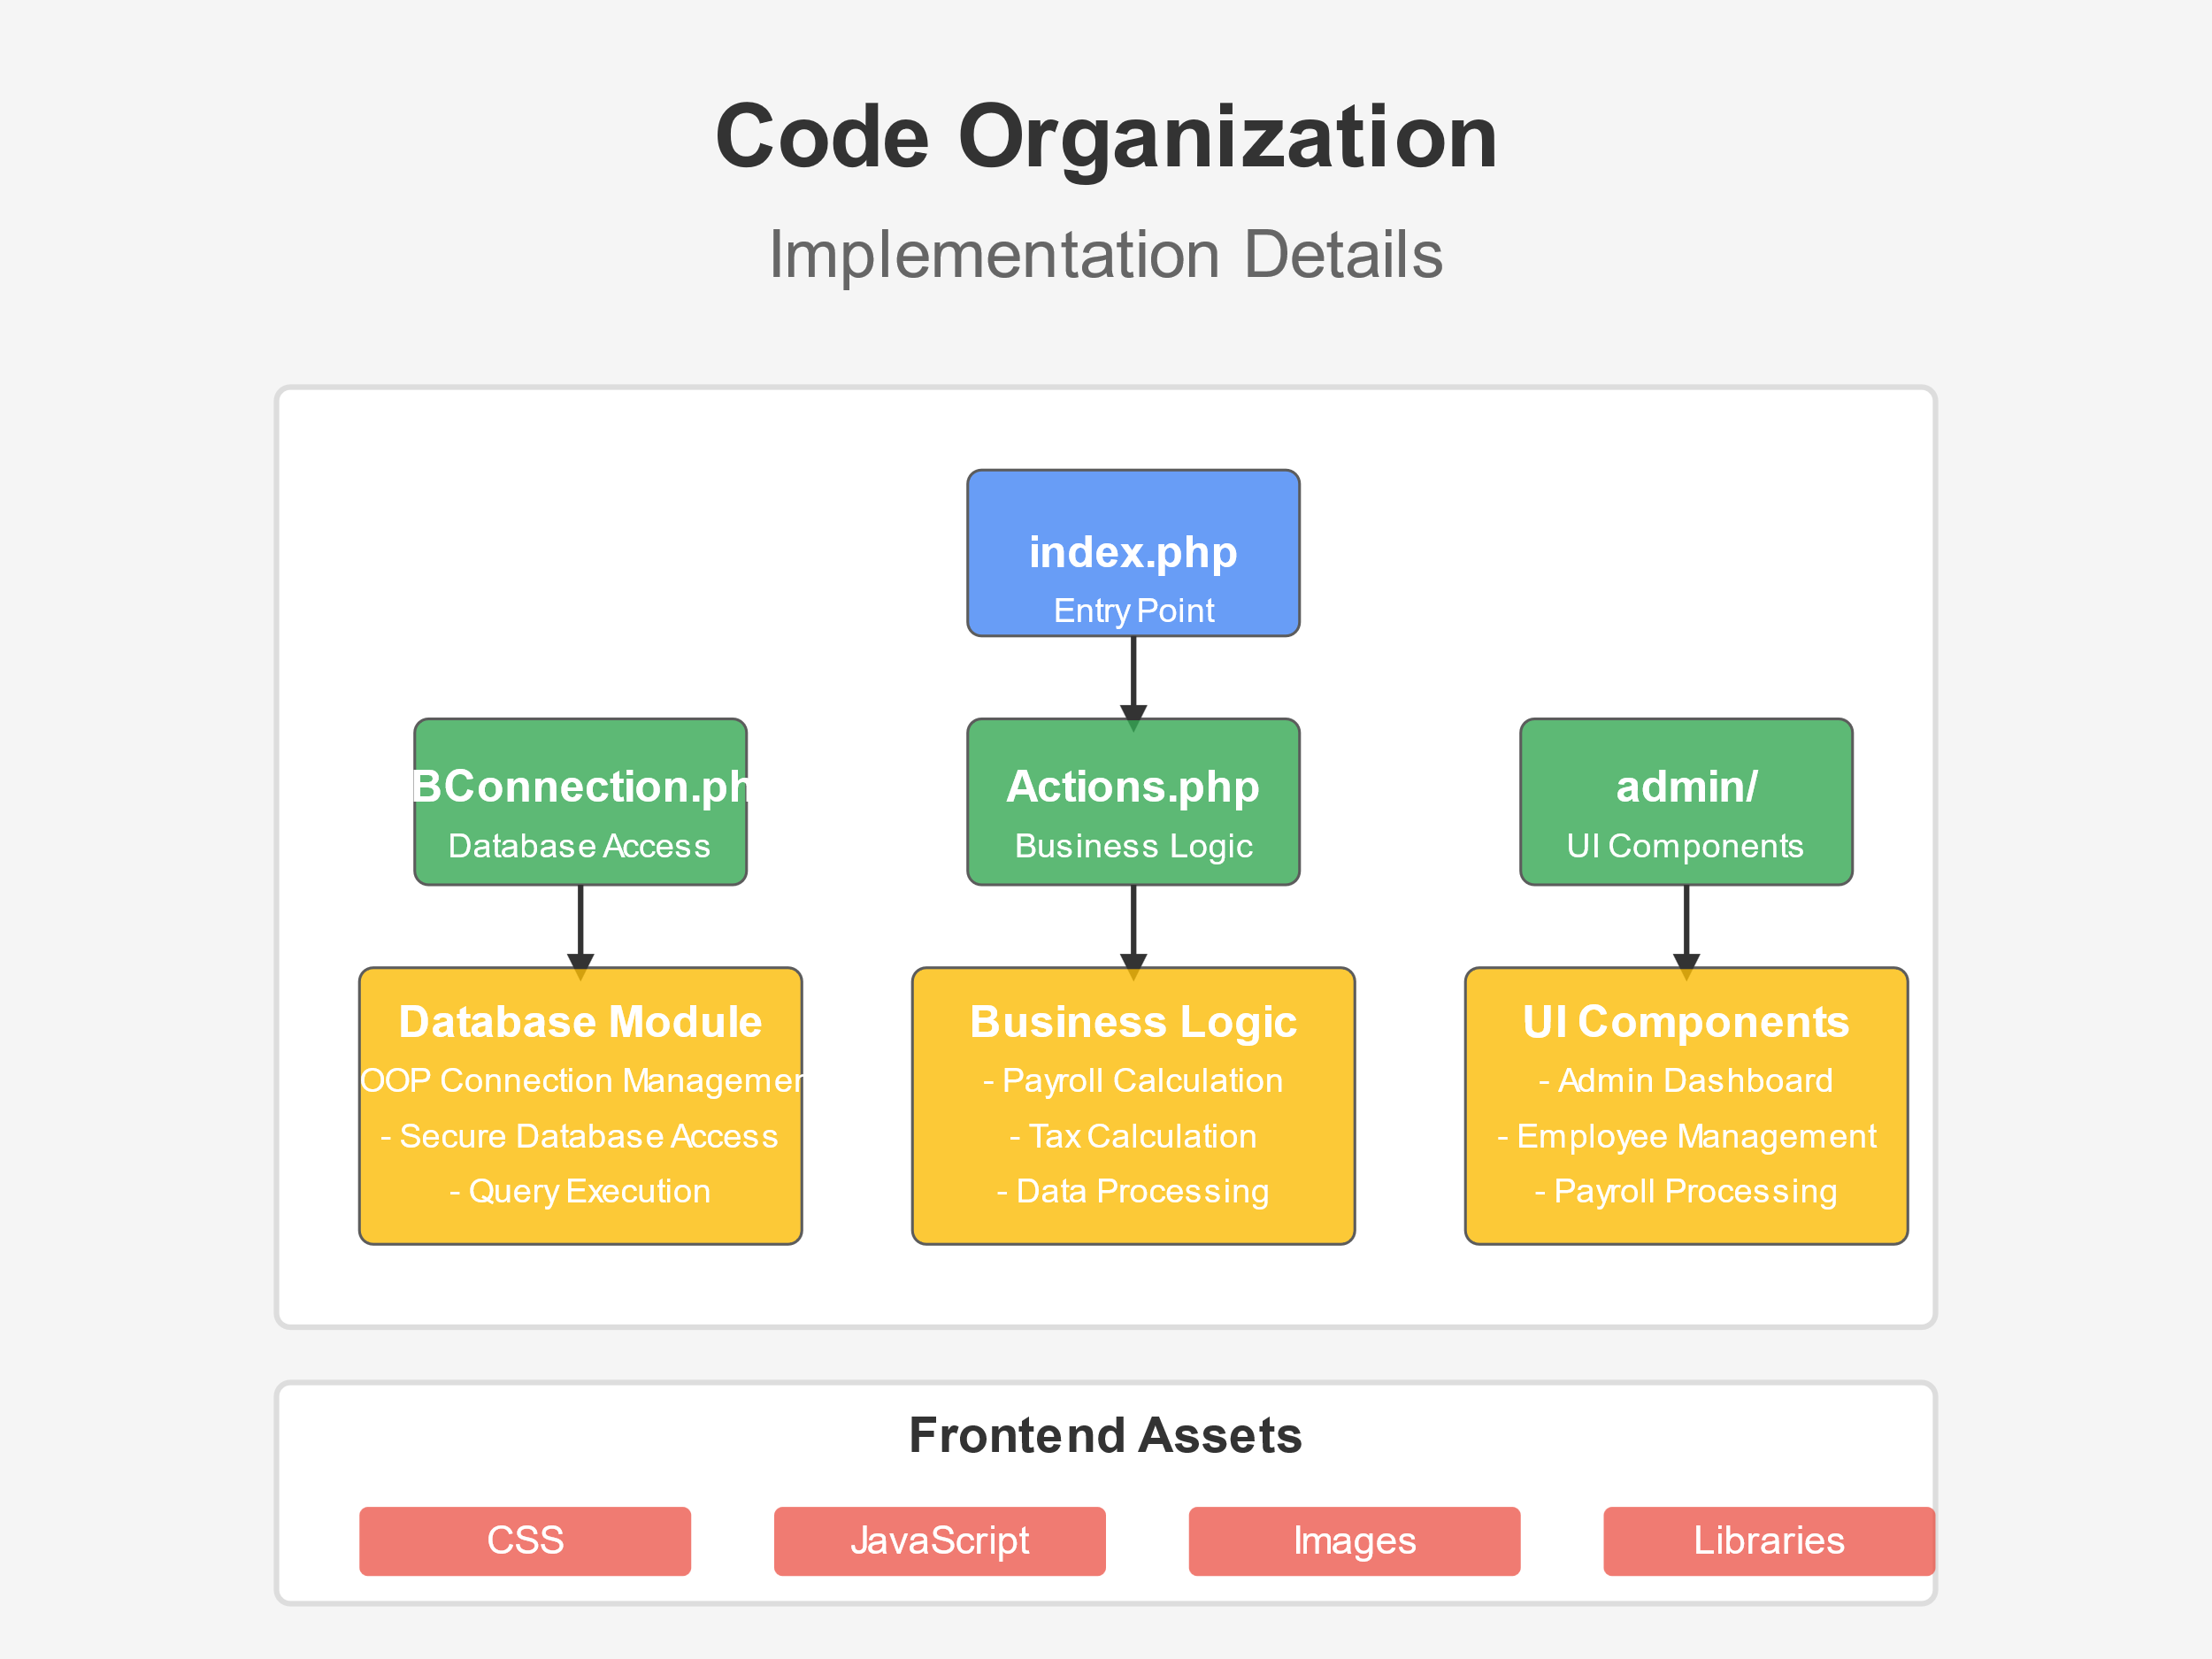

Slide 9
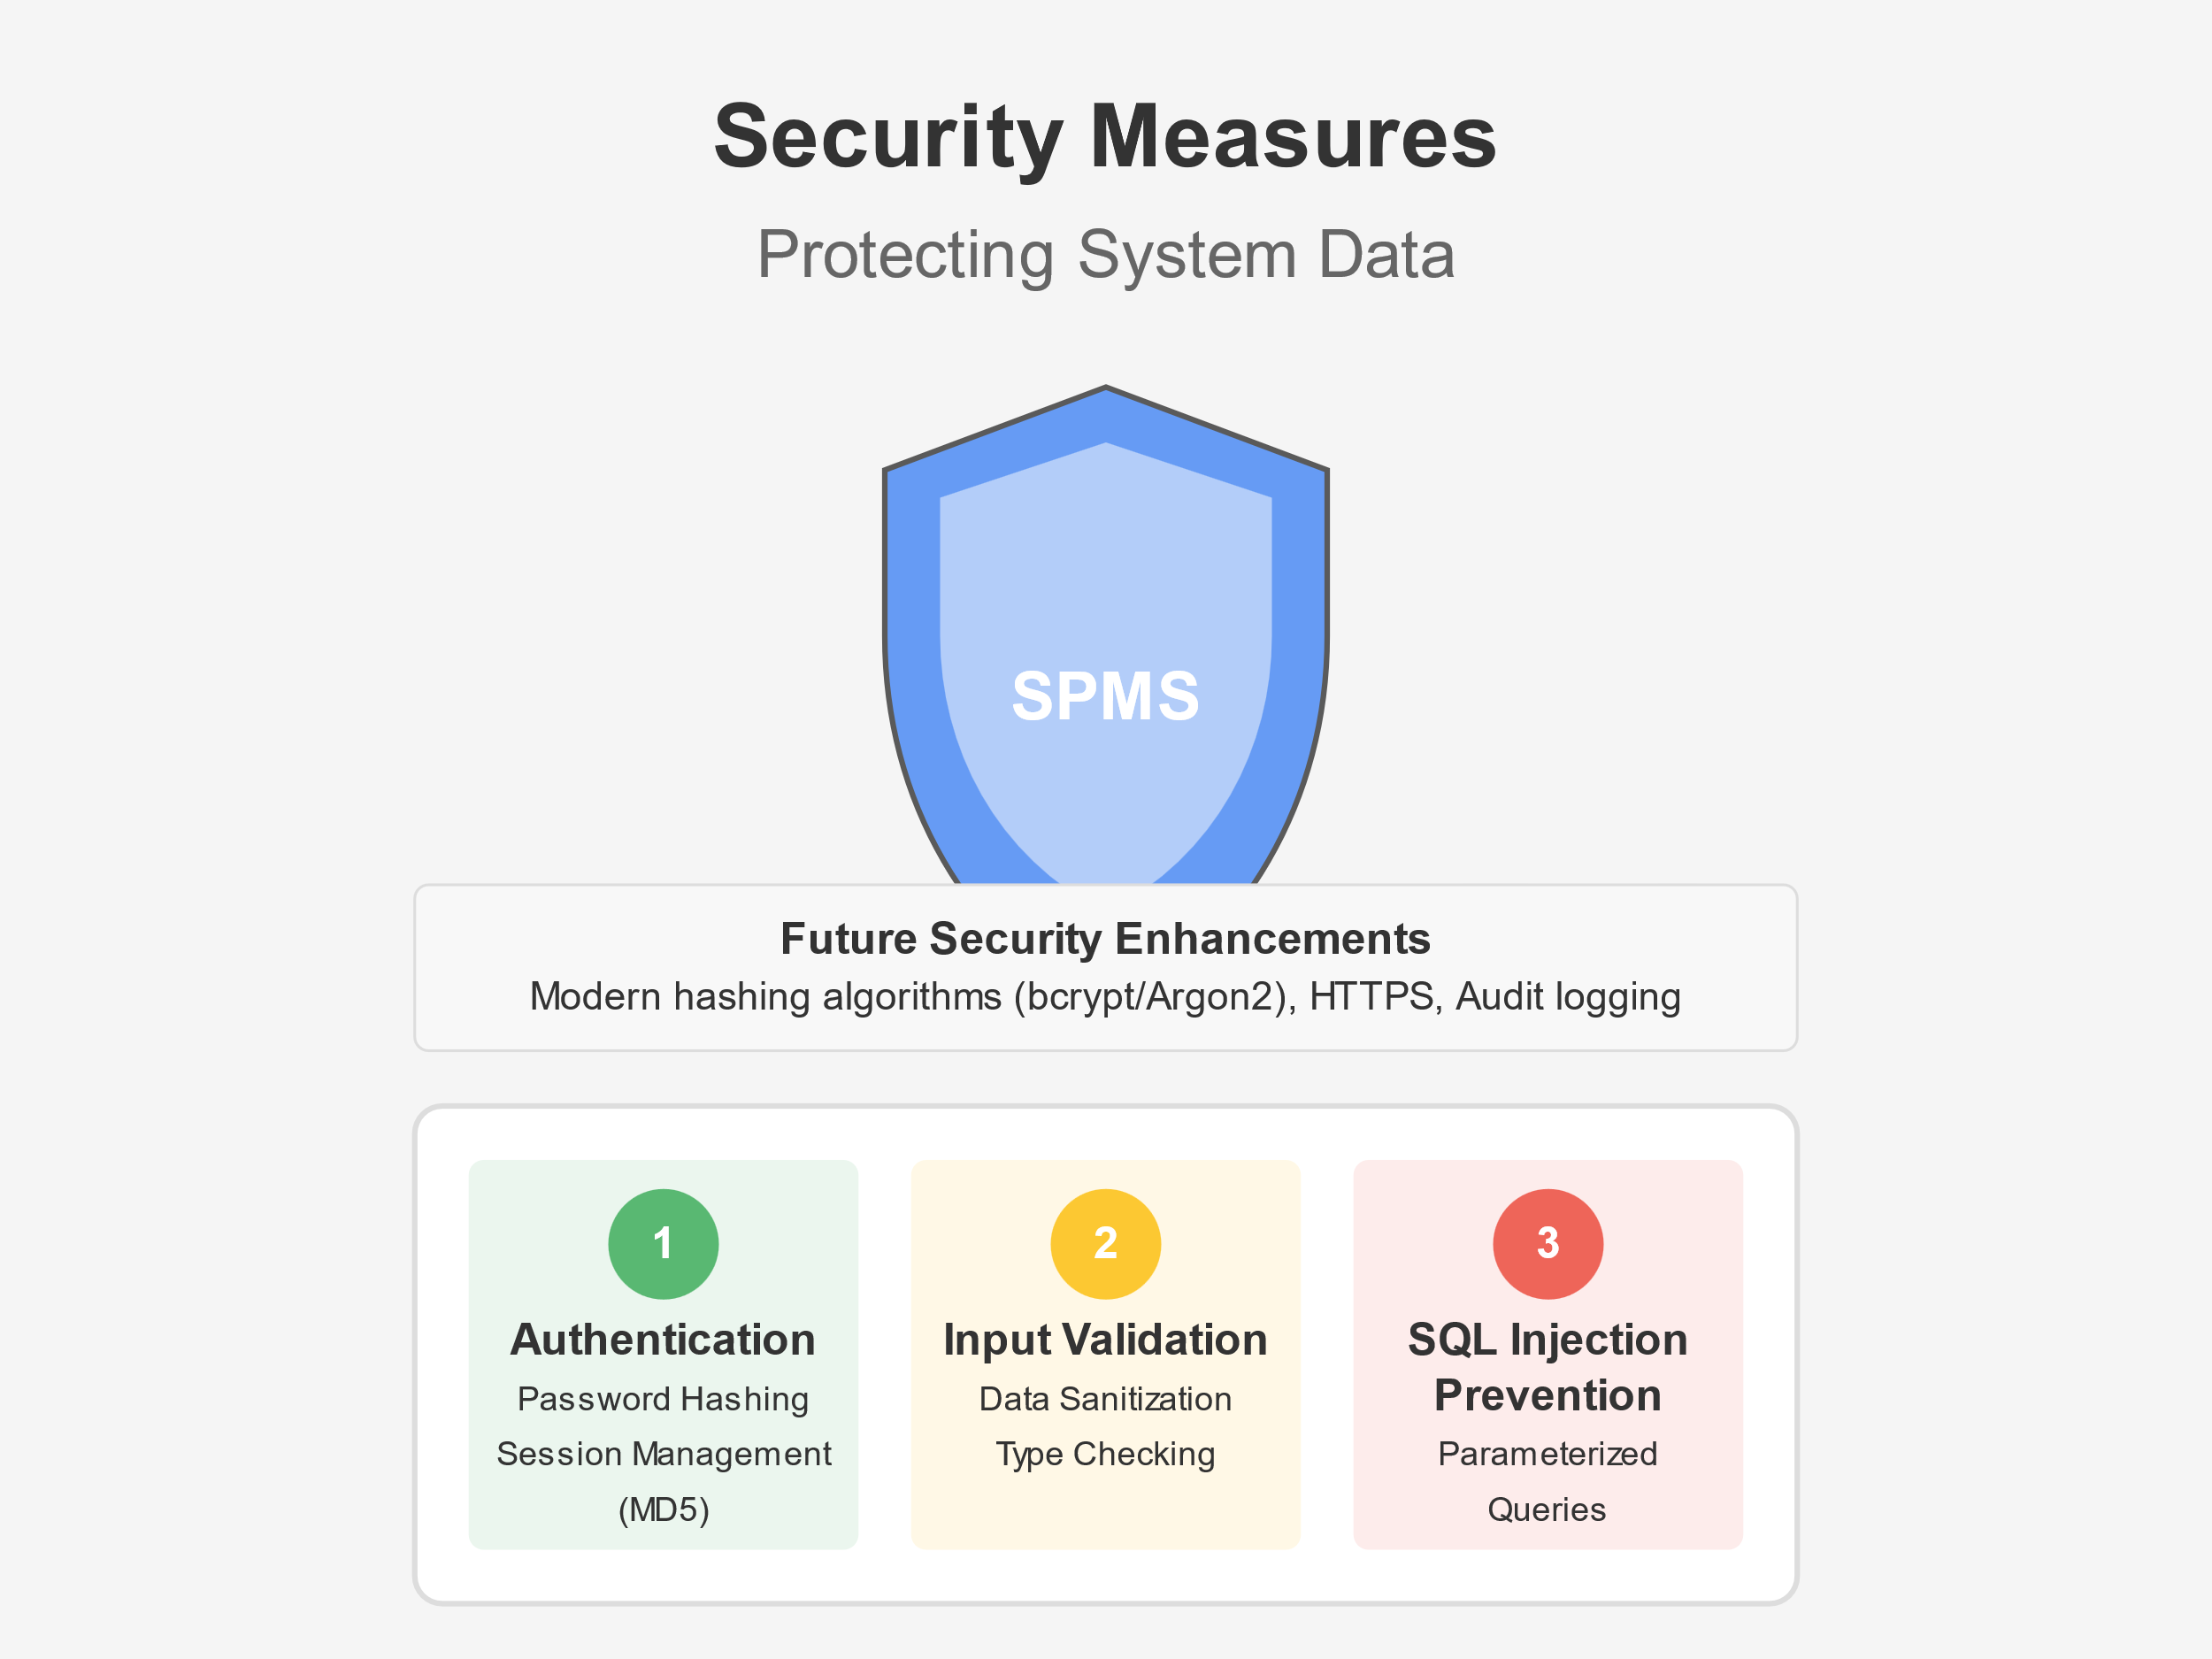

Slide 10
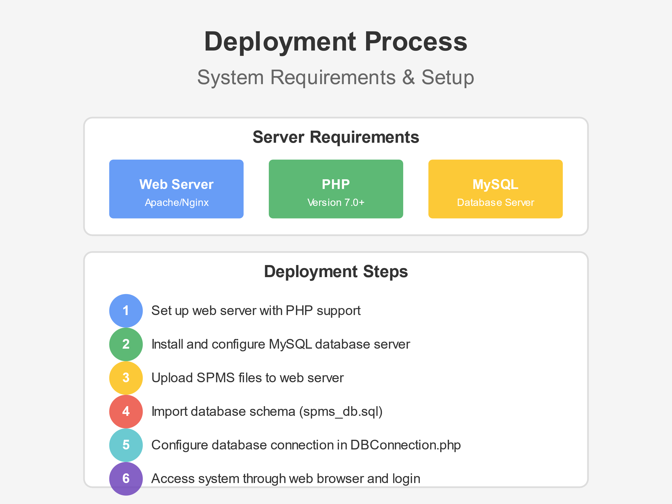

Slide 11
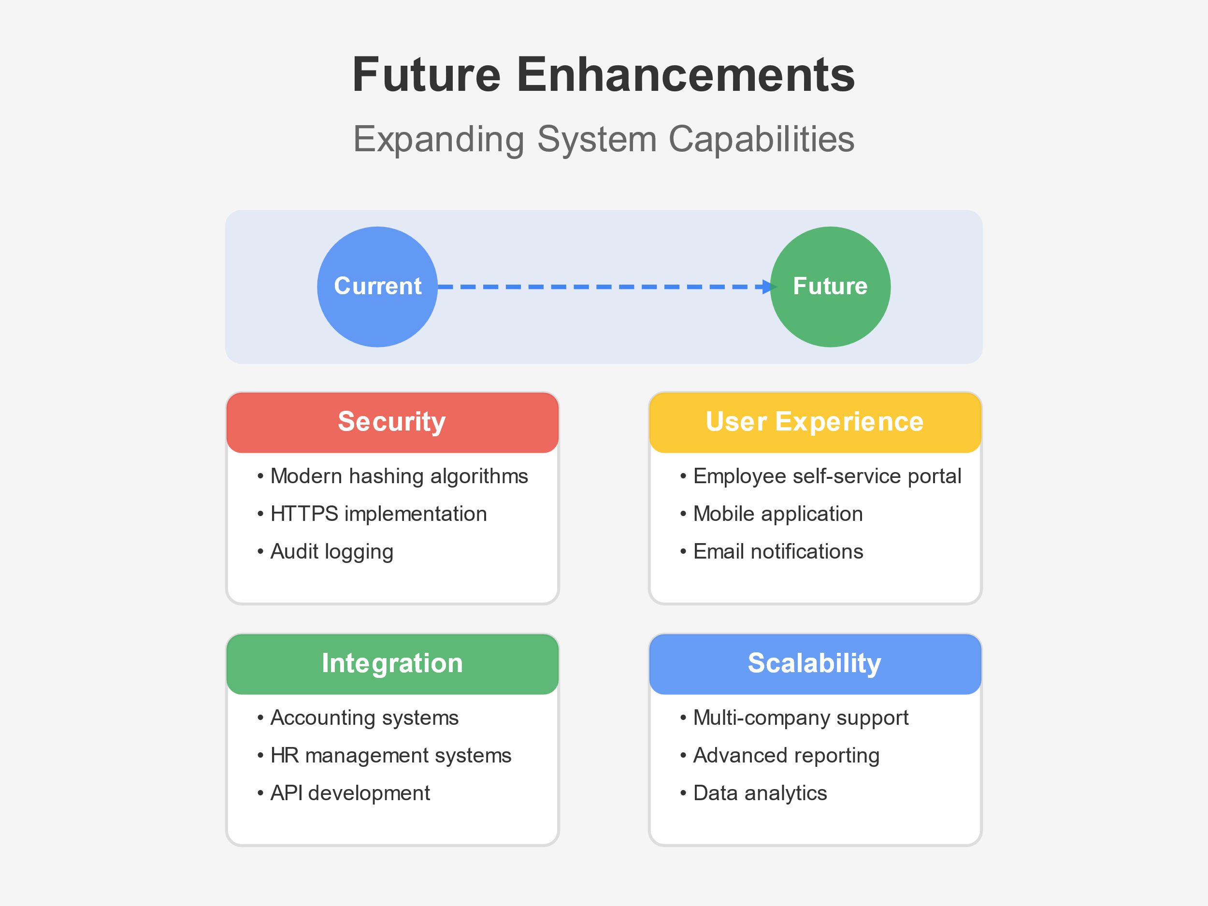

Slide 12
THANK YOU!

